Slide 1

Healthcare Management System using SQL and MongoDB
Group 3
Fyrooz Anika Khan
Fred Liu
Fardin Hafiz
Suraj Ravindra Kapare
10th December 2024

Slide 2
Background And Objective
Overview of the Project:
Developing a system to manage patient and appointment data effectively.
Demonstrate the capabilities of SQL and MongoDB in real-world healthcare applications.
Facilitate meaningful queries to:
Retrieve specific patient and appointment data.
Perform updates, deletions, and aggregations efficiently.

Slide 3
SQL vs. MongoDB
Structure
SQL
Defined schema, relational data.
Uses primary and foreign keys for relationships.
MongoDB
Flexible schema, document-oriented.
Nested objects for complex relationships.
SQL is structured, uses predefined schemas, and maintains data integrity through primary and foreign keys.
MongoDB offers flexibility with nested documents and arrays, making it suitable for unstructured or semi-structured data.

Slide 4
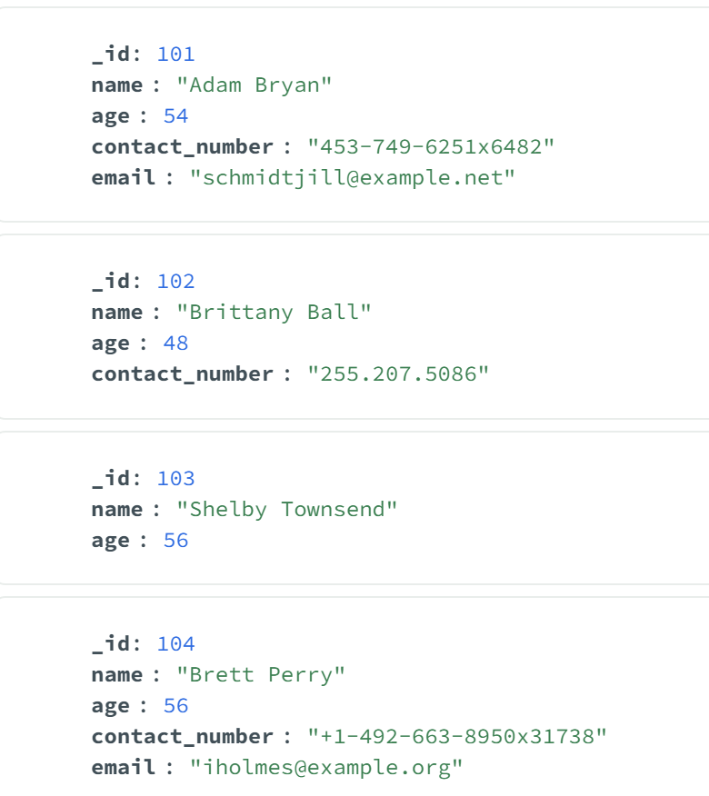
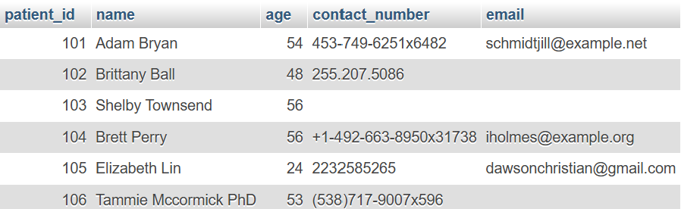
DATA GENERATION
Output
Patient Records:
Attributes: name, age, contact_number, email.
Unique identifiers:
SQL: patient_id (AUTO_INCREMENT starting from 101).
MongoDB: _id (sequence starting from 101).
Emails:
Randomized mix of Gmail and other domains.
Optional Fields:
Some patients lack contact numbers or emails for data variability.

Slide 5
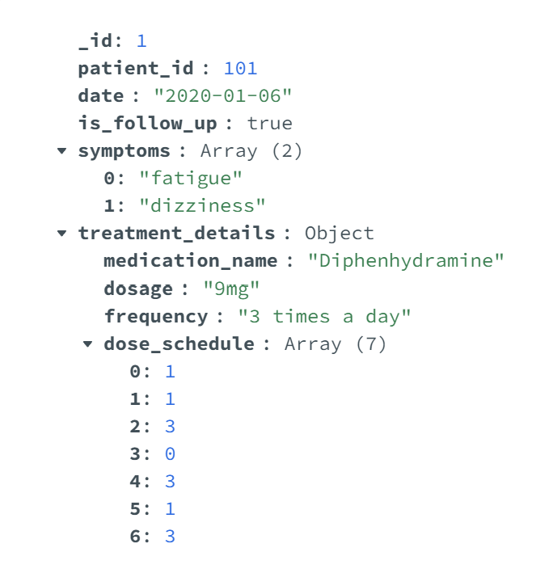
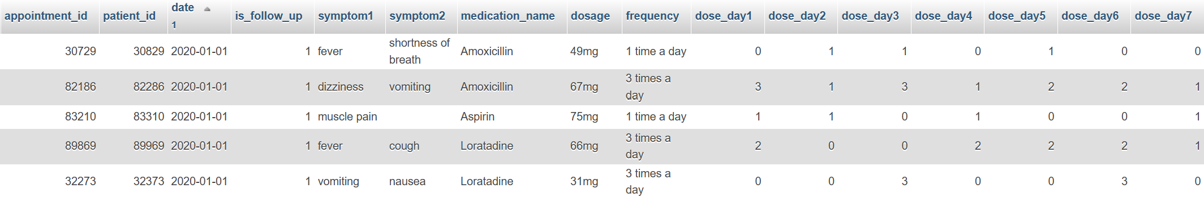
DATA GENERATION
Output
Appointment Records:
Attributes include:
SQL: Individual columns for symptom1, symptom2, dosage, and dose_day1 to dose_day7.
MongoDB: Nested objects for treatment_details and arrays for symptoms and dose_schedule.
Randomized attributes:
Symptoms drawn from a list of 10 common health issues.
Medication details (name, dosage, frequency) and weekly dose schedules.
Unique identifiers:
SQL: appointment_id (AUTO_INCREMENT).
MongoDB: _id (sequence coded by Python).

Slide 6
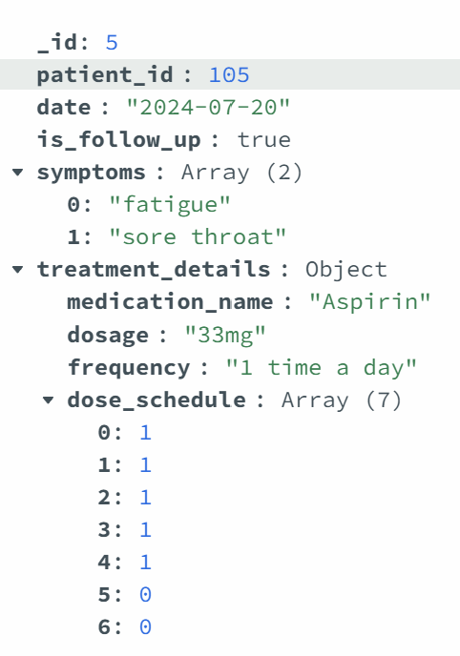
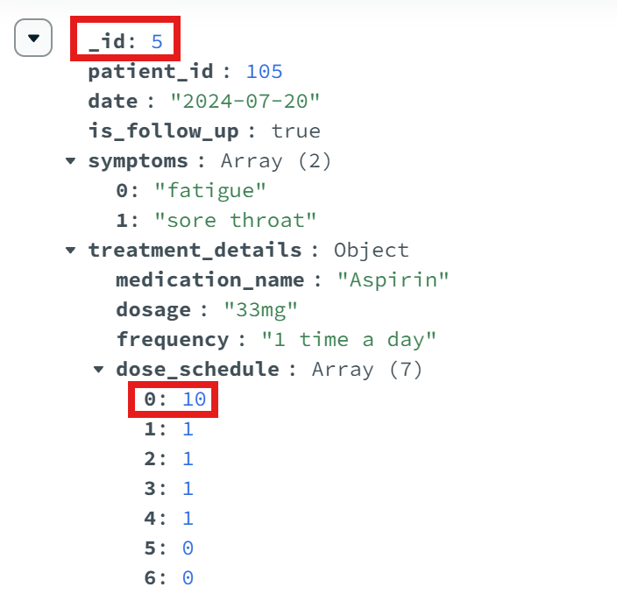
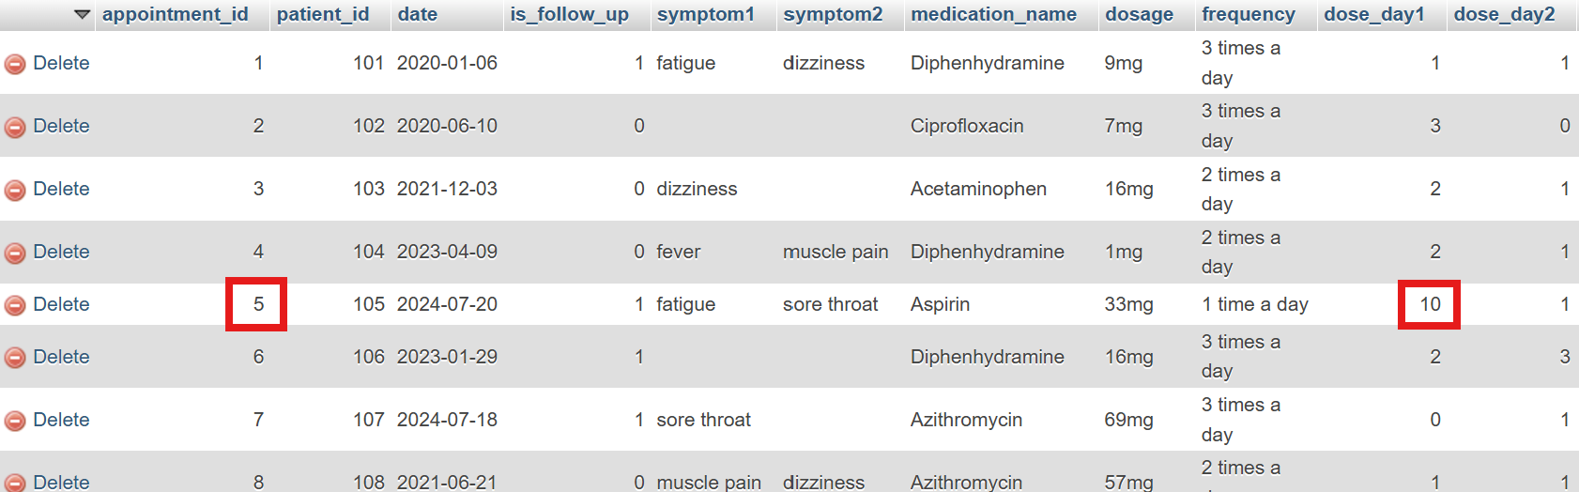
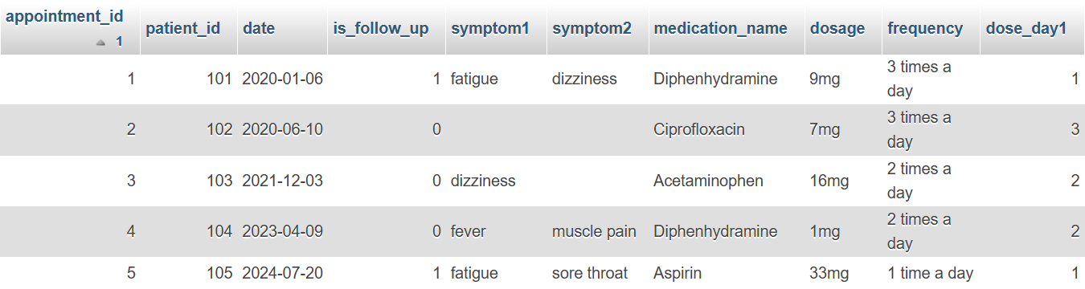
Task 1
Update the First Element in an Array Inside a Nested Object
SQL Query Script:
UPDATE appointmentdetails
SET dose_day1 = 10
WHERE appointment_id = 5;
MongoDB Shell Script :
db.Appointments.updateOne(
{ _id: 5 },
{ $set: { "treatment_details.dose_schedule.0": 10 } }
);

Slide 7
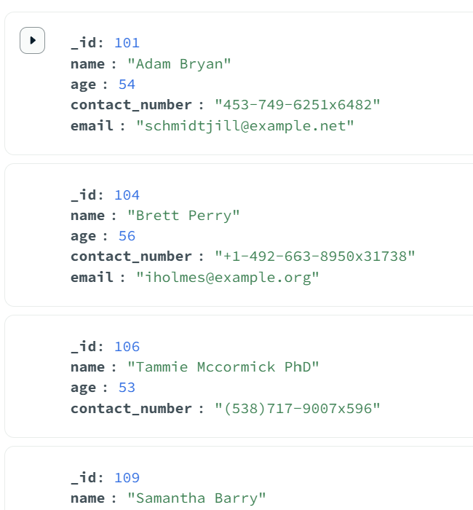
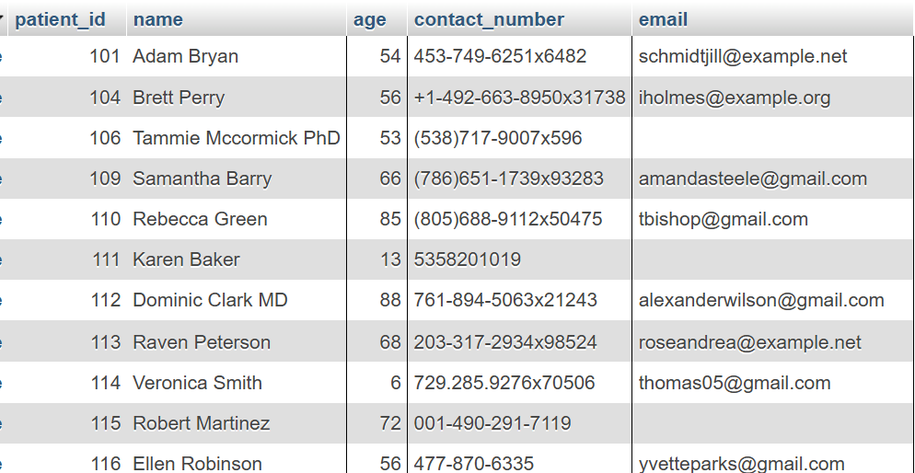
Task 2
Retrieve Patients with Specific Criteria
MongoDB Shell Script :
db.Patients.find({
$and: [
{
$or: [
{ age: { $lt: 20 } },
{ age: { $gt: 50 } }
]
},
{
$or: [
{ contact_number: { $ne: null } },
{ email: { $ne: null } }
]
}
]
})
SQL Query Script:
SELECT *
FROM patientdetails
WHERE (age < 20 OR age > 50)
AND ((contact_number IS NOT NULL AND contact_number <> '') OR (email IS NOT NULL AND email <> ''));

Slide 8
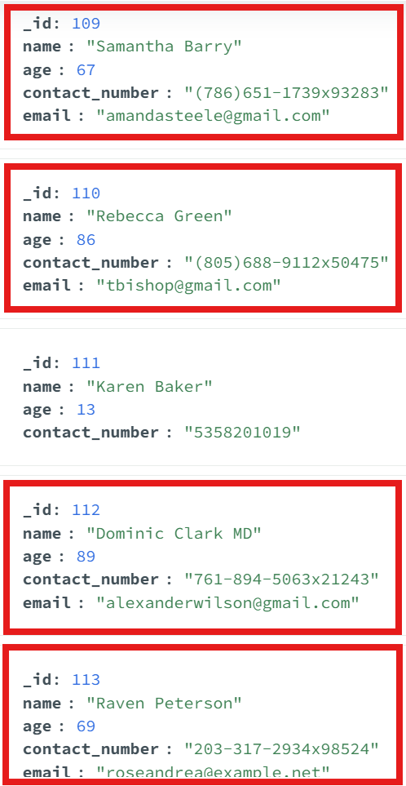
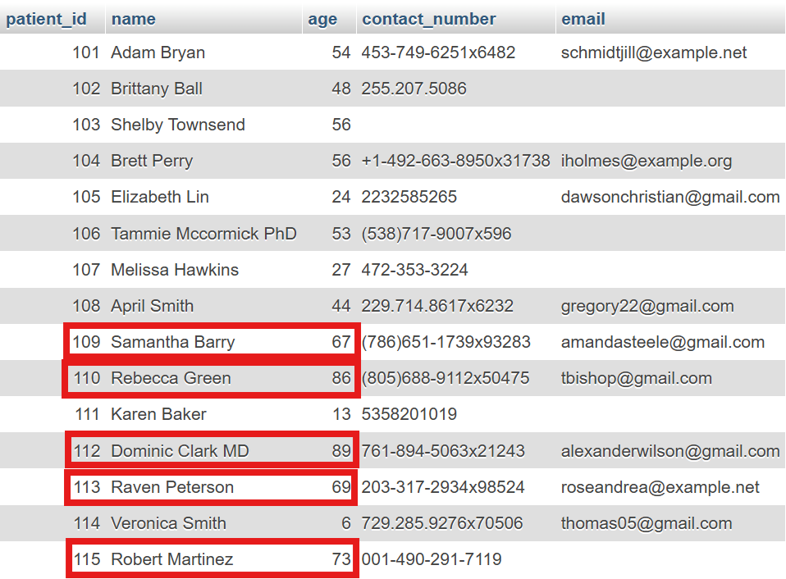
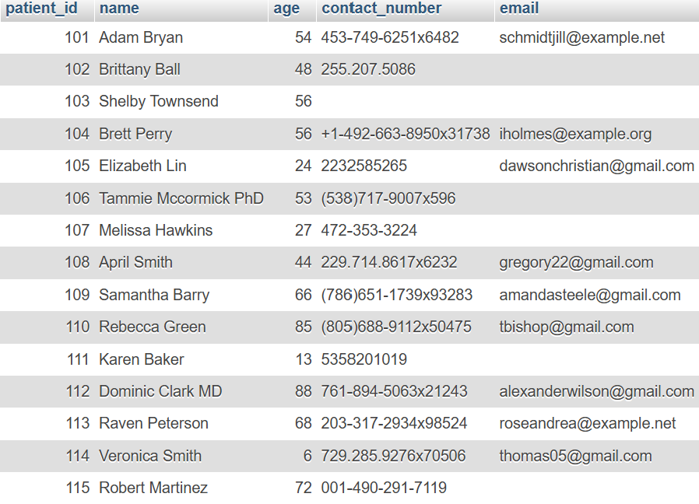
Task 3
Increase Age by 1 Year for All Patients Over 60
MongoDB Shell Script :
db.Patients.updateMany(
{ age: { $gt: 60 } },
{ $inc: { age: 1 } }
);
SQL Query Script:
UPDATE patientdetails
SET age = age + 1
WHERE age > 60;

Slide 9
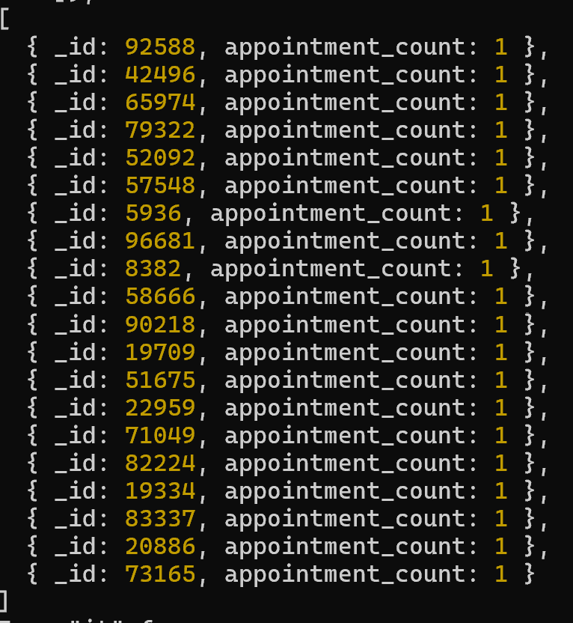
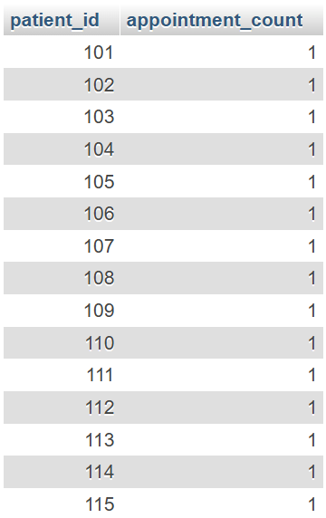
Task 4
Perform Aggregation to Count Appointments by Patient
SQL Query Script:
SELECT patient_id, COUNT(*) AS appointment_count
FROM appointmentdetails
GROUP BY patient_id;
MongoDB Shell Script :
db.Appointments.aggregate([
{
$group: {
_id: "$patient_id",
appointment_count: { $sum: 1 }
}
}
]);

Slide 10
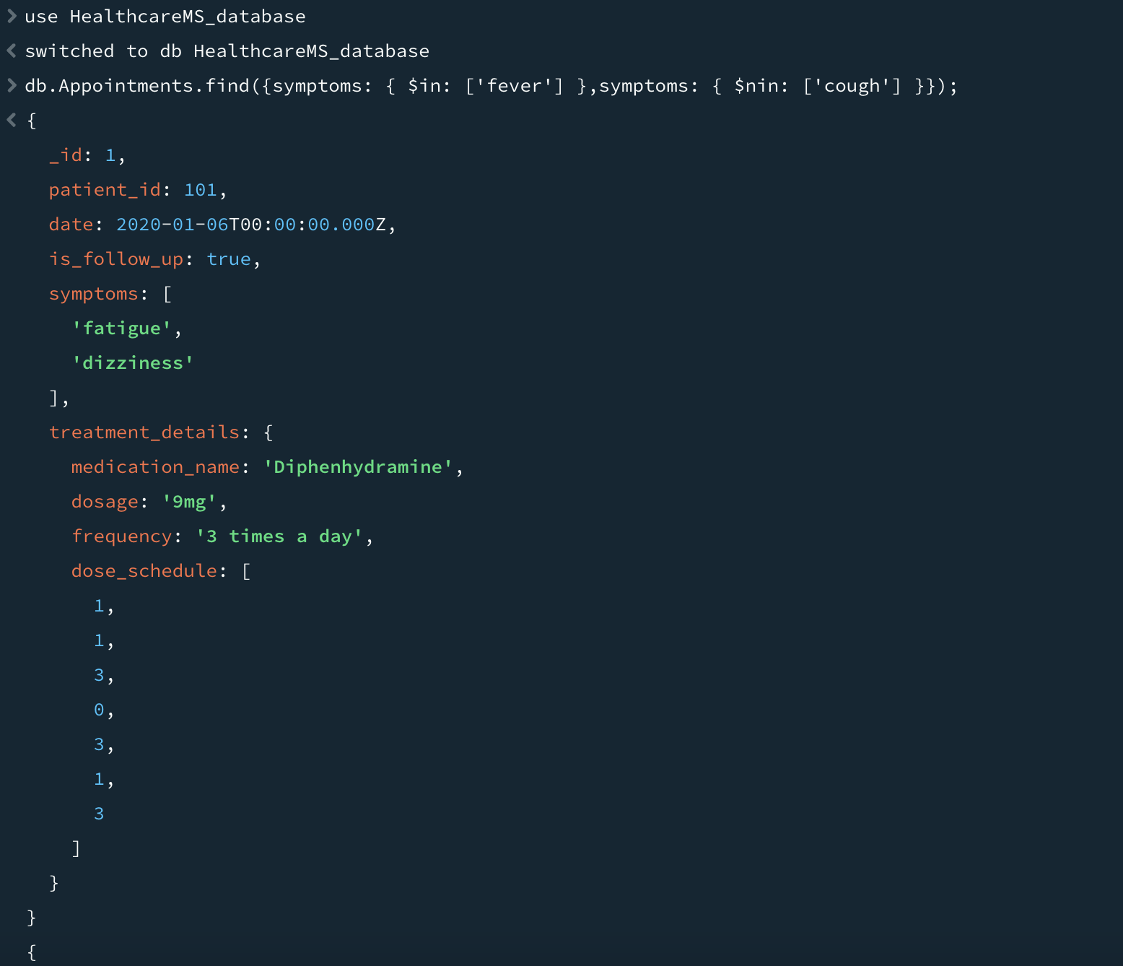
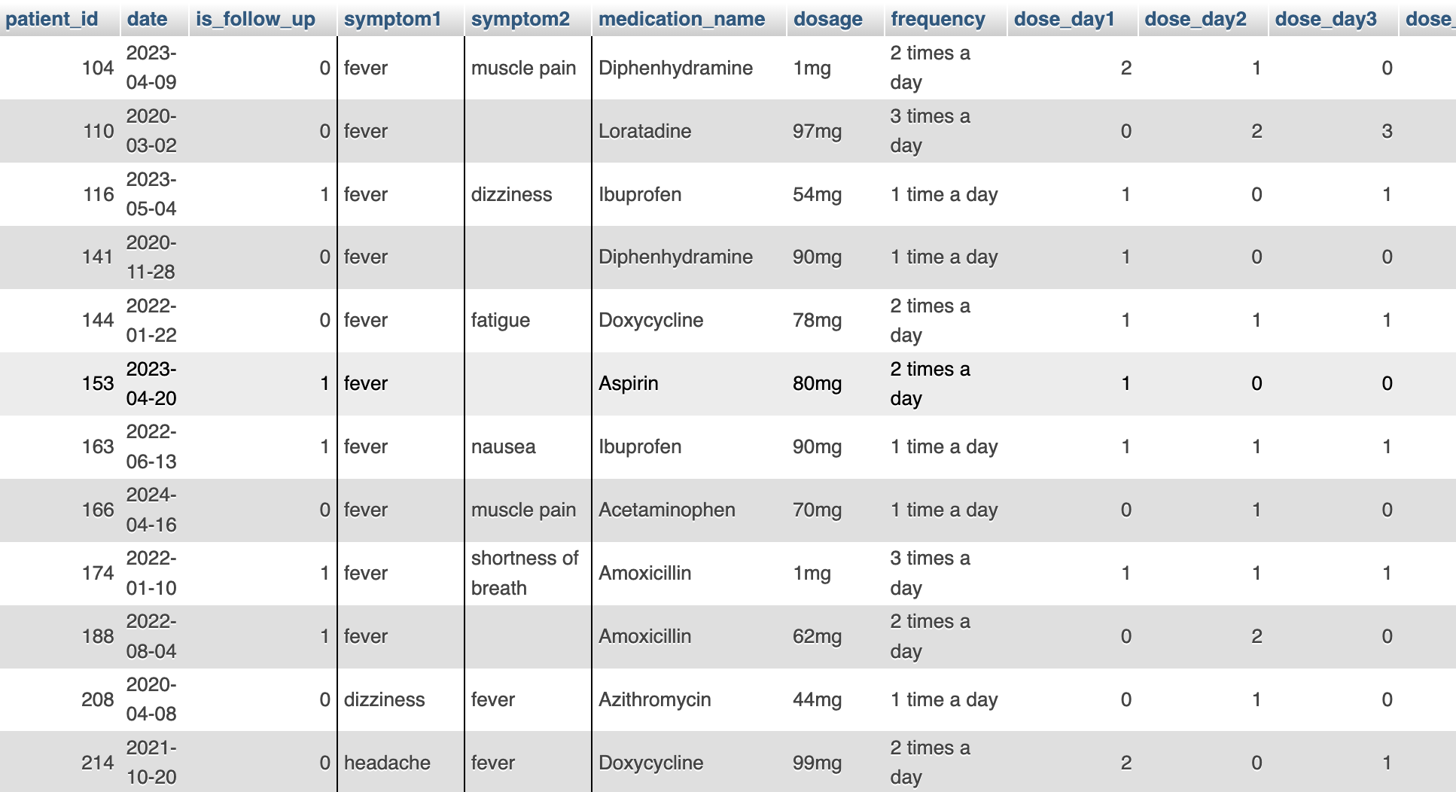
Task 5
Identify and retrieve appointments where the symptoms include "fever" but exclude "cough".
SQL Query Script:
'''
SELECT *FROM appointments_sql
WHERE ('fever' IN (symptom1, symptom2))AND NOT ('cough' IN (symptom1, symptom2));
'''
MongoDB Shell Script Equivalent:
'''
db.Appointments.find({symptoms: { $in: ['fever'] },symptoms: { $nin: ['cough'] }});
'''

Slide 11
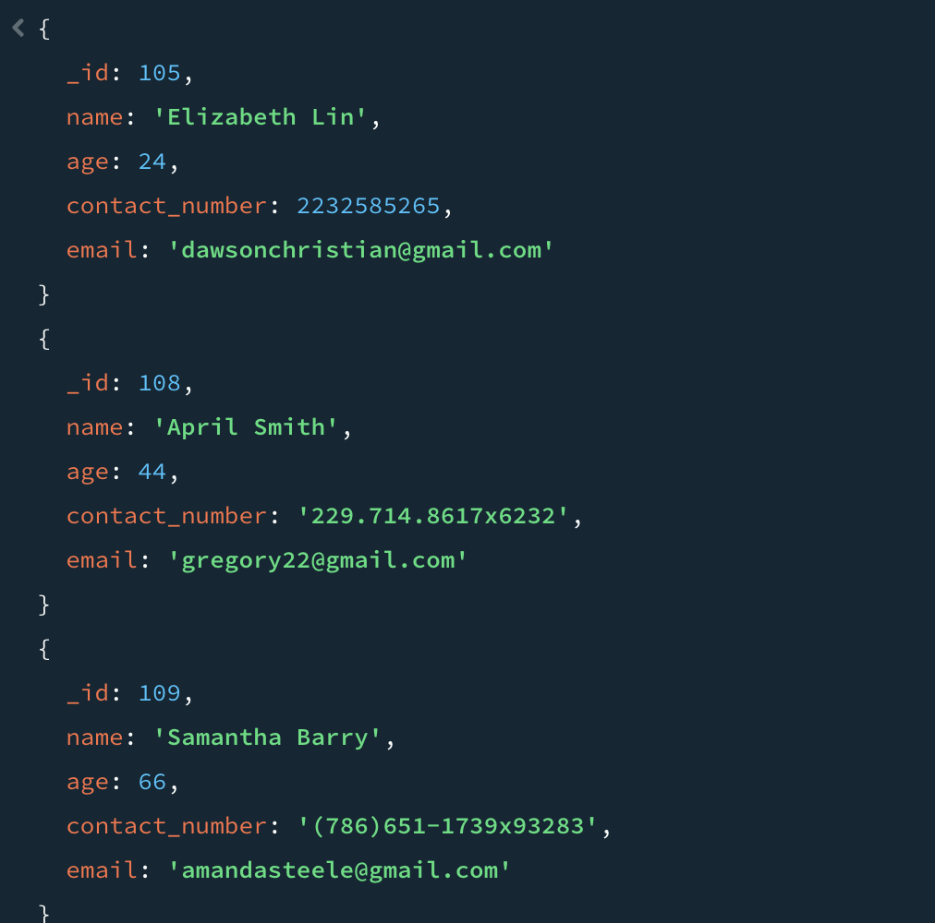
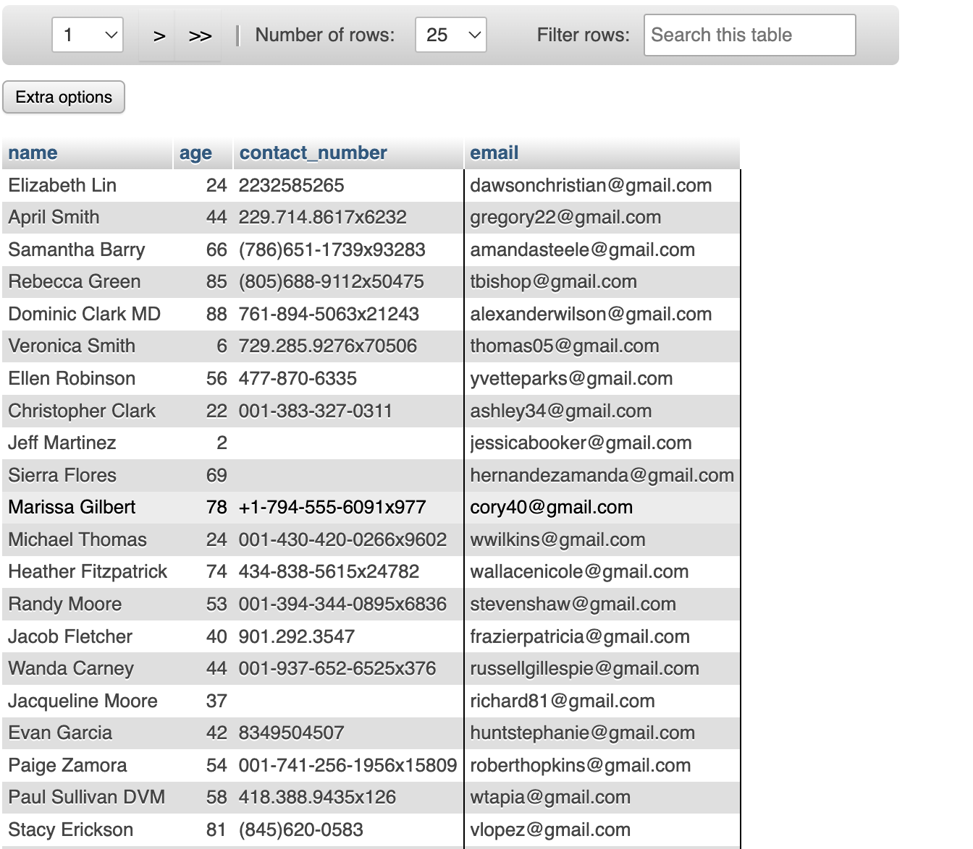
Task 6
Task: Retrieve Patients with Email Addresses from Gmail
SQL Query Script:
'''
SELECT *FROM patients_sql WHERE email LIKE '%@gmail.com';
'''
MongoDB Shell Script Equivalent:
'''
db.Patients.find({email: { $regex: /@gmail\.com$/i }});
'''

Slide 12
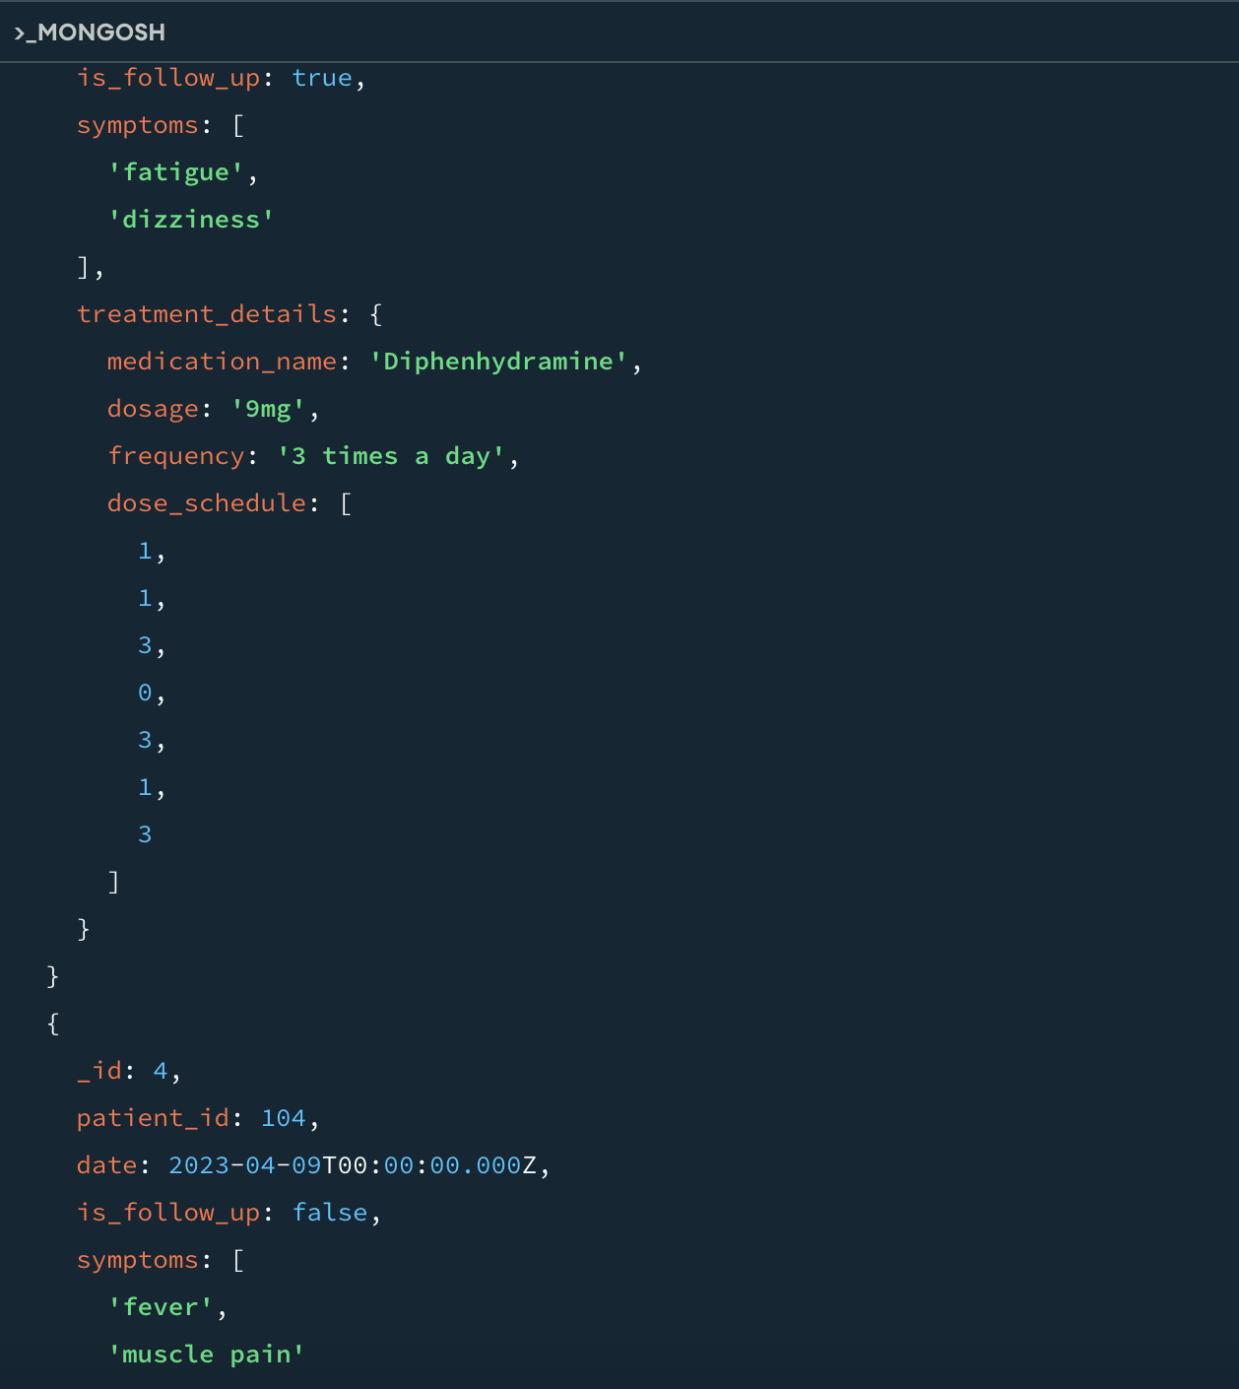
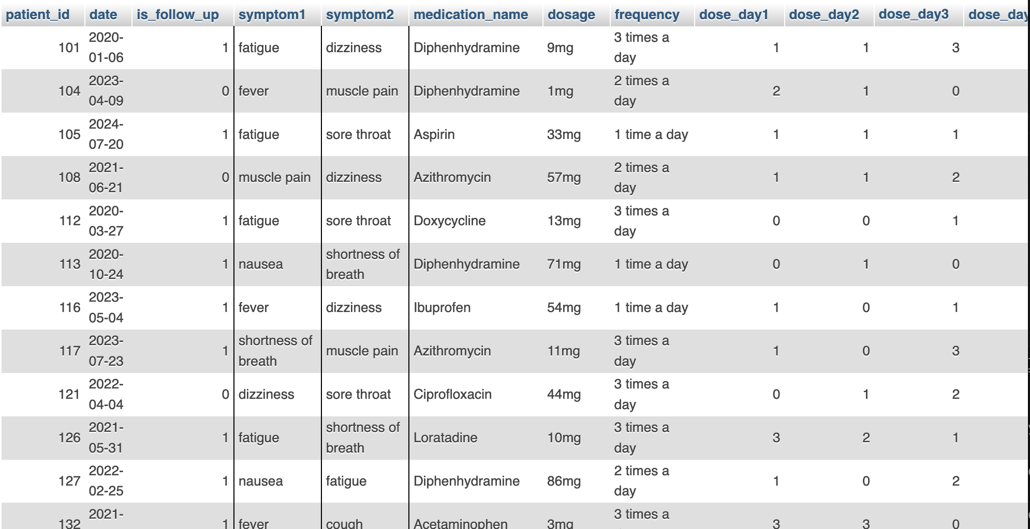
Task 7
Task: List Appointments Where More Than One Symptom Was Reported
SQL Query Script:
'''
SELECT *
FROM appointments_sql
WHERE symptom1 <> '' AND symptom2 <> '';
'''
MongoDB Shell Script Equivalent:
'''
db.Appointments.find({$expr: { $eq: [{ $size: "$symptoms" }, 2] }});
'''

Slide 13
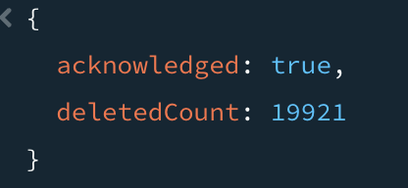
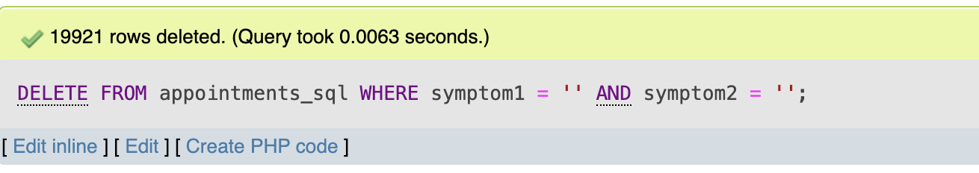
Task 8
Task: Remove Appointments with No Reported Symptoms
SQL Query Script:
'''
DELETE FROM appointments_sql
WHERE symptom1 = '' AND symptom2 = '' ;
'''
# MongoDB Shell Script Equivalent:
'''
db.Appointments.deleteMany({symptoms: { $size: 0 }});
'''

Slide 14
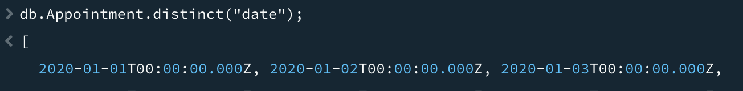
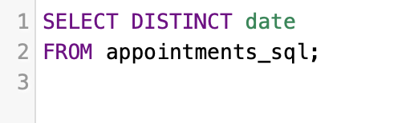
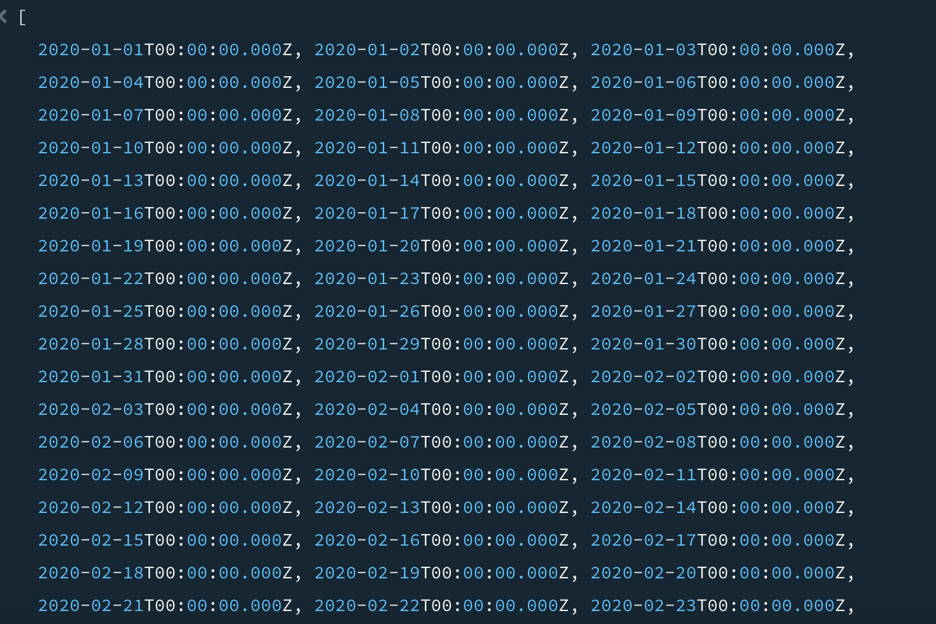
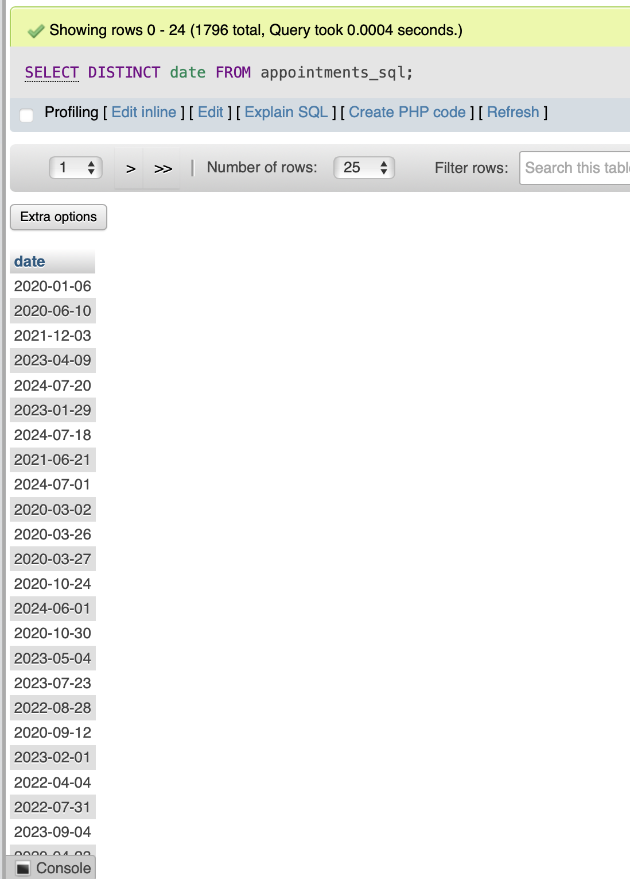
Task 9​
Retrieve Distinct Appointment Dates
Mongodb shell script equivalent
SQL Query Script:

Slide 15
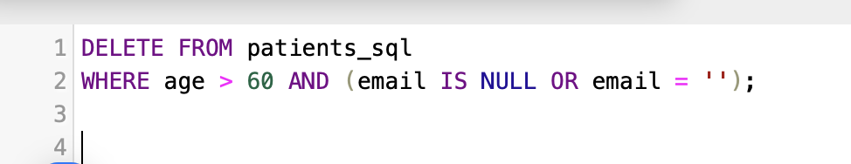
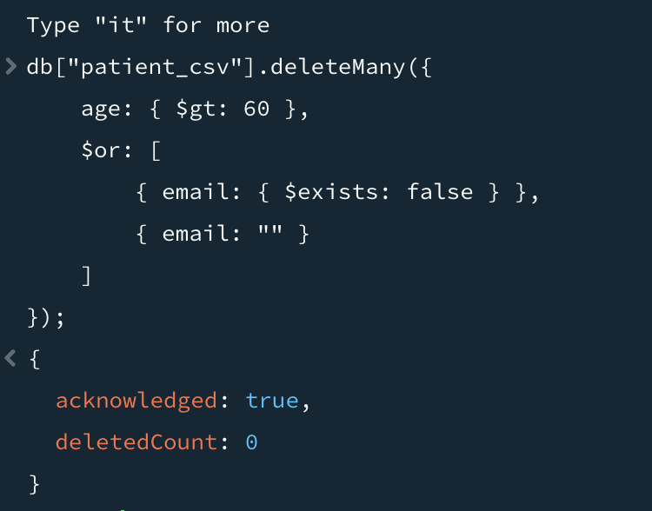
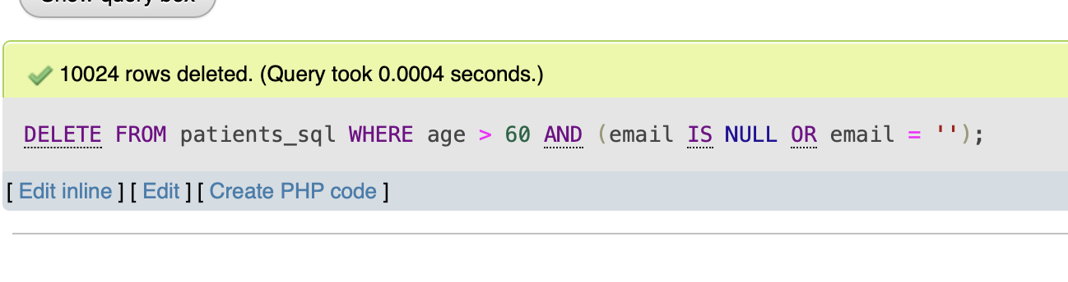
Task 10
Delete Patients Over Age 60 with No Email
SQL Query Script:
Mongodb shell script equivalent

Slide 16
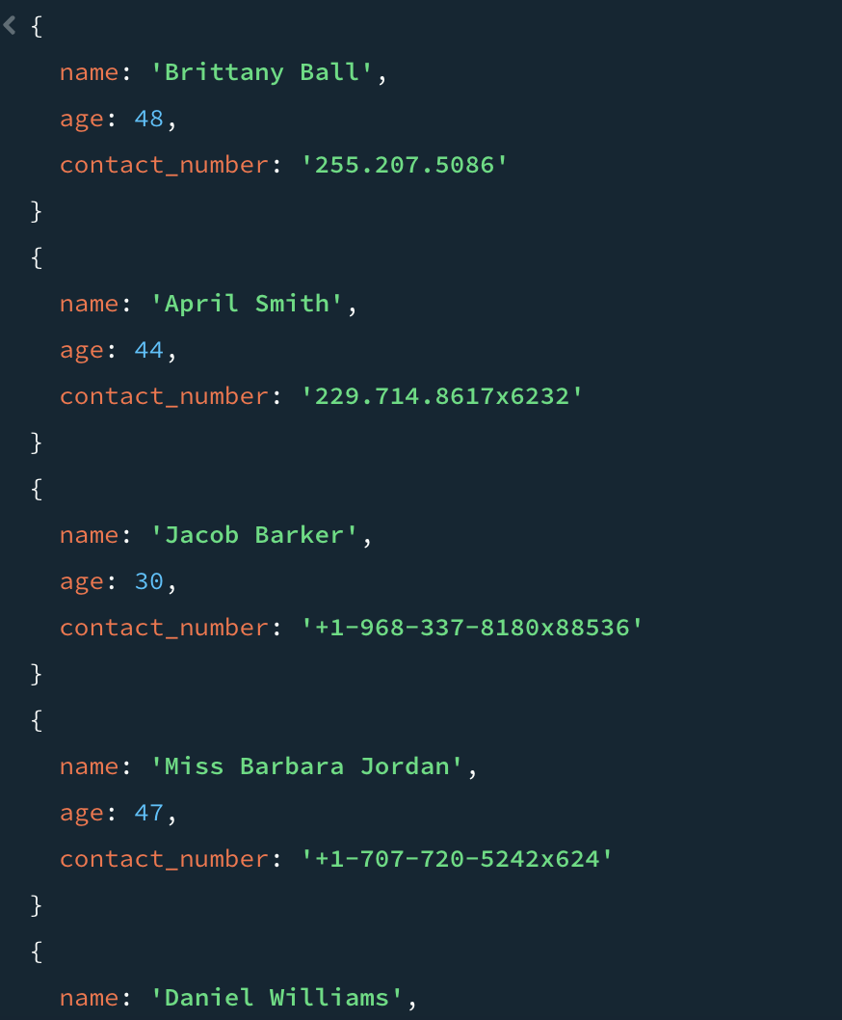
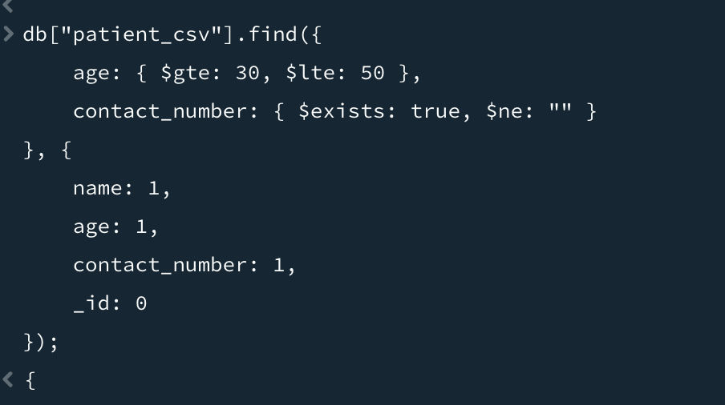
Task 11
Retrieve Patients Aged Between 30 and 50 with Contact Information
Mongodb shell script equivalent

Slide 17
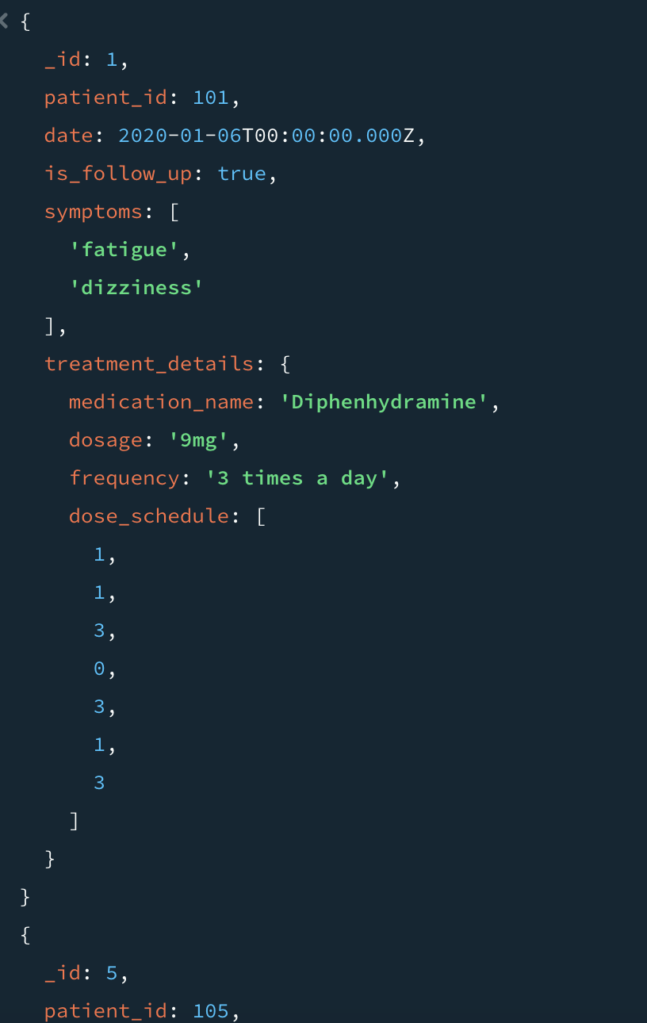
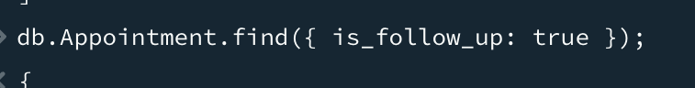
Task 12
List Appointments Marked as Follow-Up
Mongodb shell script equivalent​

Slide 18
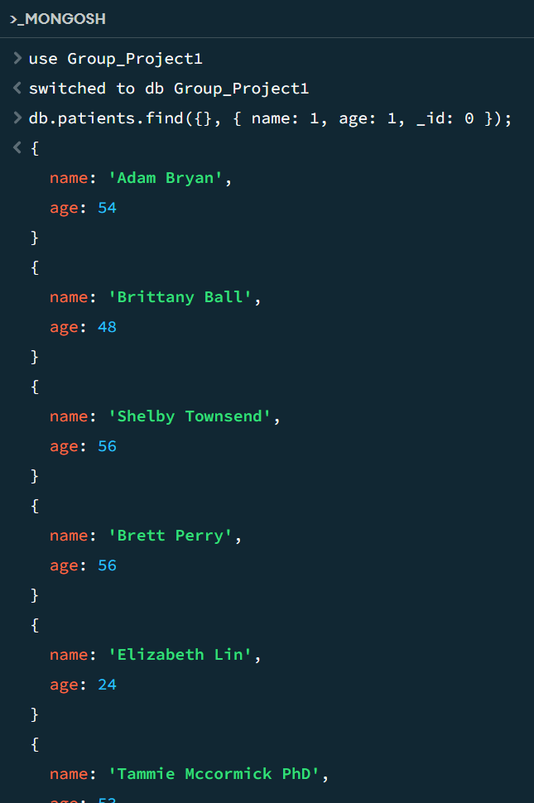
Task 13
Retrieve All Patients' Names and Ages
MongoDB Shell Script:
db.patients.find({}, { name: 1, age: 1, _id: 0 });
find(): Retrieves documents from the patients
collection.
{}: Empty filter criteria, meaning all documents are retrieved.
{ name: 1, age: 1, _id: 0 }: Projection that
specifies which fields should be included or excluded
in the results.

Slide 19
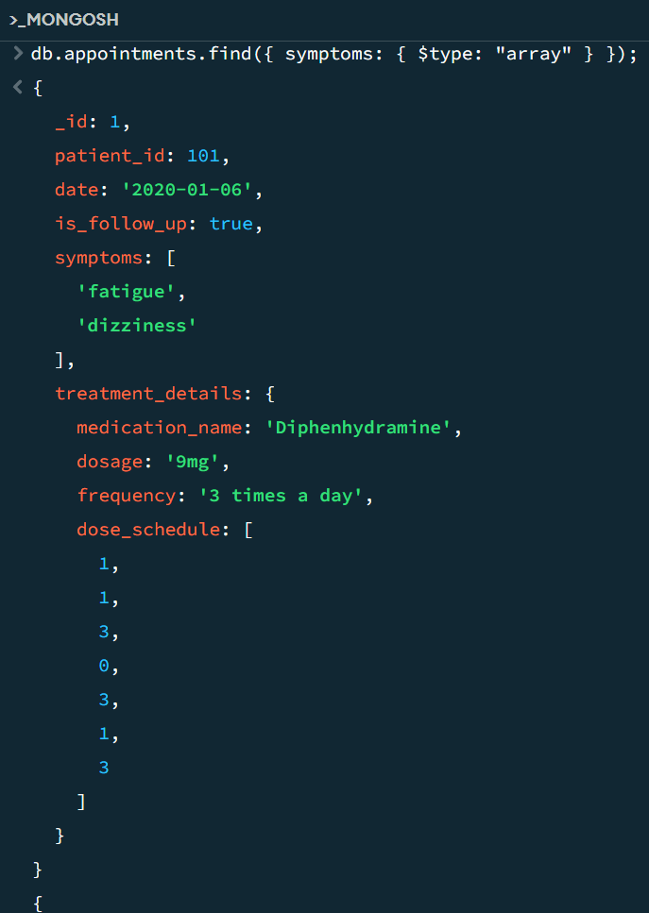
Task 14
Find Appointments with Symptoms in an Array
MongoDB Shell Script:
db.appointments.find({ symptoms: { $type: "array" } });
{symptoms:{$type:"array"}}: Filter criteria.
symptoms: Specifies the field to evaluate.
$type:"array": Checks if the symptoms field in each
document is of type array.

Slide 20
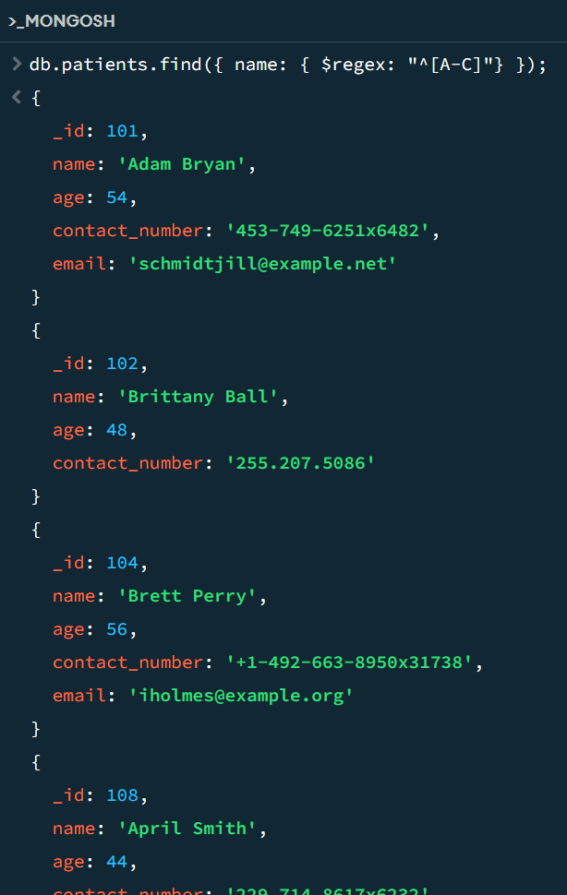
Task 15
Retrieve Patients with Names Starting with Specific
Letters Using Regular Expressions
MongoDB Shell Script:
db.patients.find({ name: { $regex: "^[A-C]"} });
name: Specifies the field to match.
$regex:"^[A-C]":
^: Hat indicates the start of the string.
[A-C]: Matches any character in the range A to C.

Slide 21
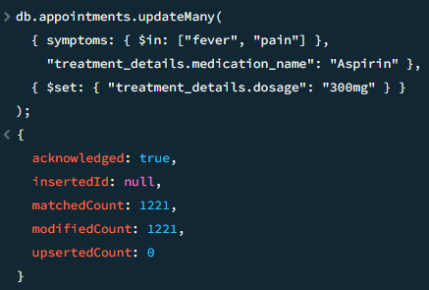
Task 16
Update Medication Dosage for Specific Conditions
MongoDB Shell Script:
db.appointments.updateMany(
{ symptoms: { $in: ["fever", "cough"] }, "treatment_details.medication_name": "Ibuprofen" },
{ $set: { "treatment_details.dosage": "300mg" } }
);
updateMany(): Update multiple documents that match
the specified filter criteria.
{ symptoms: ... }: Filter criteria
{ $set: …}: Update operation

Slide 22
Execution Time Query Results
SQL is more suitable
complex filtering, aggregations, or joins, such as (e.g., Task 2) or counting appointments (e.g., Task 4),
Execution time is generally less for such tasks.
MongoDB excels in
direct matching, searching for specific values, and simple aggregations (e.g., Task 5 and Task 9),
Average execution time is lower than SQL
SQL Average Execution Time
2.7239/10 = 0.27239 seconds
MongoDB Average Execution Time
3.835/10 = 0.3835 seconds

Slide 23
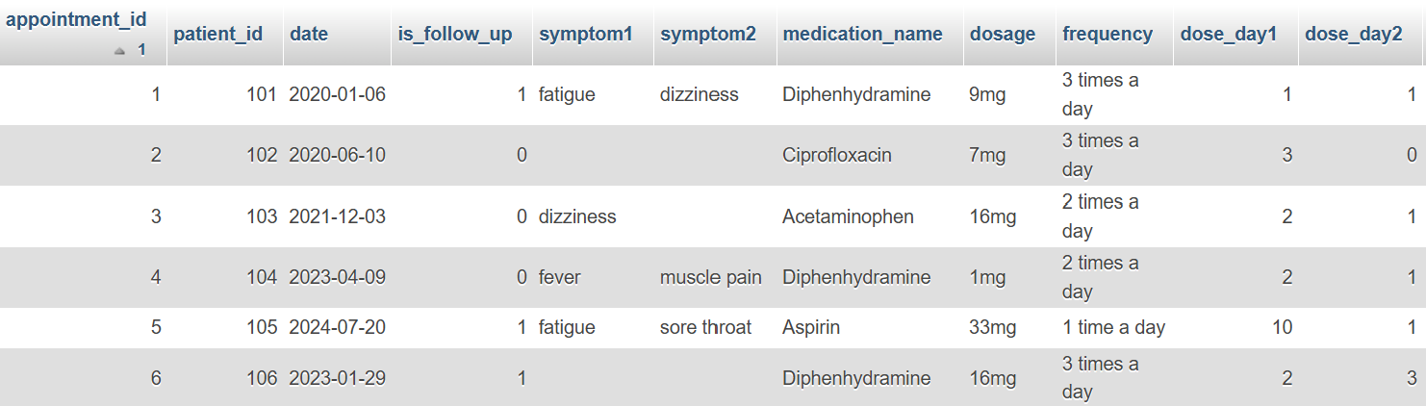
Conclusion
Limitations:
Dataset could be enhanced with more diverse and comprehensive records to better simulate real-world scenarios.
Performance metrics may vary with different hardware and larger datasets.
SQL appears to be more efficient for complex queries, while MongoDB is faster for simpler queries.

Slide 24
Thank You!

